Slide 1
Library Management System
Abdur Rafay Saleem – 17855
Muhammad Abdul Rafay sajid - 17918

Slide 2
Business Problem
School libraries face issues manually tracking book issues, returns and members.
Members of a library can’t access book details or check availability of books remotely.
No way of showing or informing about new collections or top rated books online.

Slide 3
Objective
To streamline the process of borrowing books from the library.
To make it easier to manage book issues and returns.
To make it easier to manage member data.
To make it easier to track member issue history.
To make it easier to check available books.
To view book details and recommendations online.
To sort books according to category.

Slide 4
Back end tool
Oracle Application Express used to setup the tables and constraints.
Sequences were made for tracking primary keys.
Triggers were made to increment primary key counter automatically
Oracle Rest Data Services were used to convert table into REST API.
Custom methods were created in a package to aid with complex API calls and custom SQL queries including joins.

Slide 5
Front end tool
Flutter App Development framework was used to develop library app.
Connected to the API using Dart HTTP Client.
Parsing JSON data into classes and objects.
Data kept in sync using state management techniques and streams.
Data presented in user-friendly way to simplify usage.
Code hosted on github.
Generates an installation APK to run the app.

Slide 6
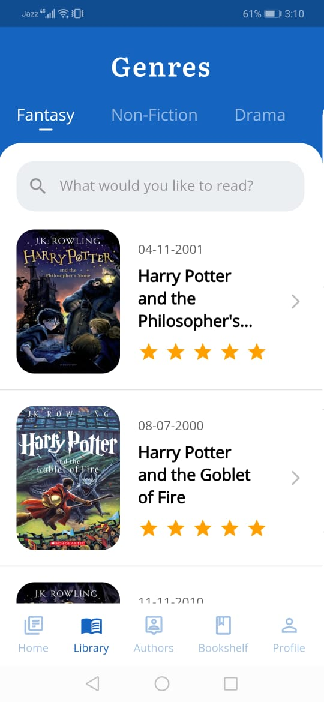
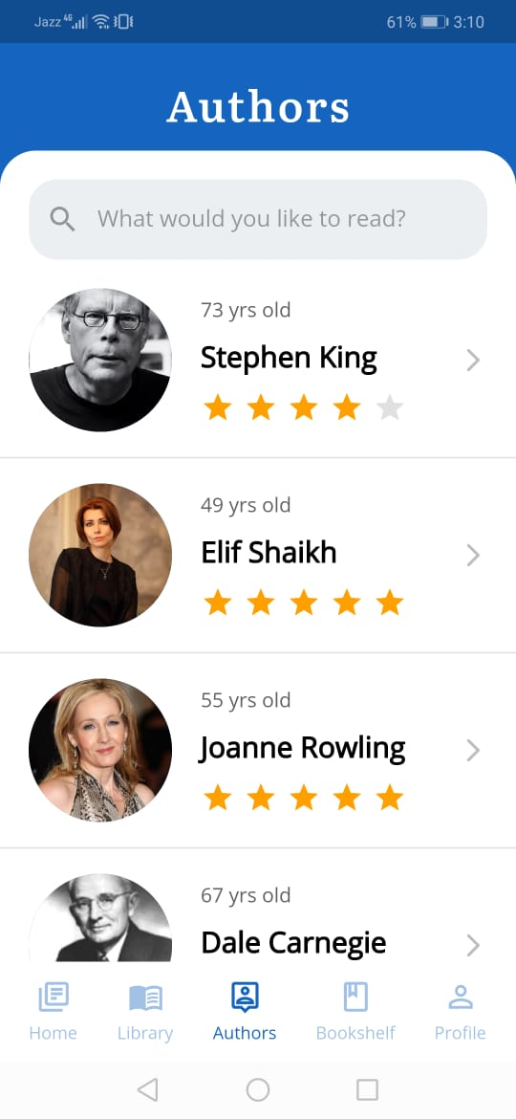
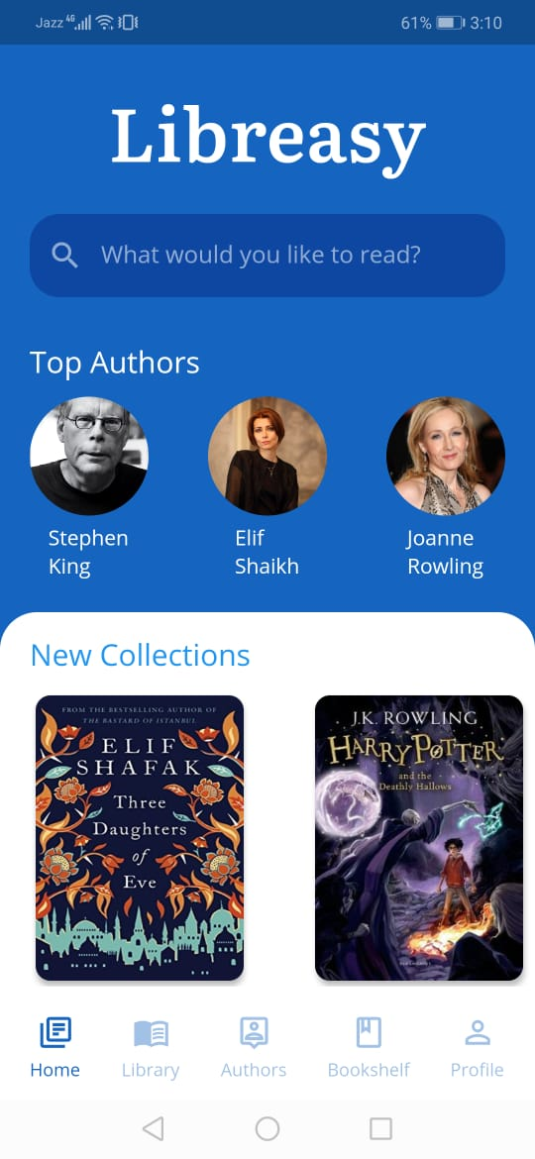
Sneak Peak

Slide 7
Demo
View the GIF or video for the demo of usage.
Alternatively, install the APK on an android device

Slide 8

THANKYOU

